Slide 1
THANK YOU

Slide 2
AIML - Cohort1
Life Expectancy
Sunil & Sreeram

Slide 3
Agenda
To write/create an automation to bring R square value for various methods and understand different parameters and their effects.

Slide 4
Data Summary (Life Expectancy Analysis)
193 countries participation
22 Factors (Columns)
15 years of data spread
Factors involved are:
Immunization
Mortality
Economical
Social
Column Name(s) | Column Data Type
Country, Status, Year | Discrete
Other | Continuous
Note: We are following regression model as output “Life Expectancy” is a continuous type output.

Slide 5
Phases
Data Column Fixes
Missing Data Identification and Columns reduction
Data Correlation and Column reductions
Outliers and Data Normalization
Data Distribution Analysis
Write Script/Automation for full analysis with various methods

Slide 6
1a. Data Column Fixes
Summary:
Remove whitespaces from both ends
Replace underscore with whitespace in between [optional]
Replace all upper cases to lower cases for uniformity [optional]
Result: Get uniform and clean columns names

Slide 7
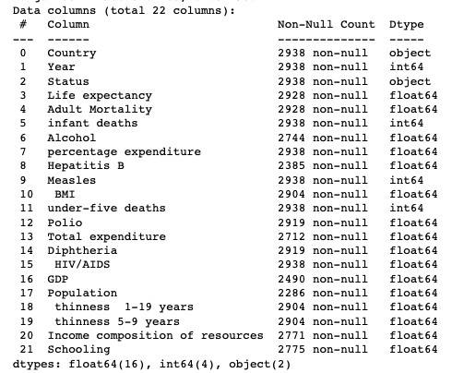
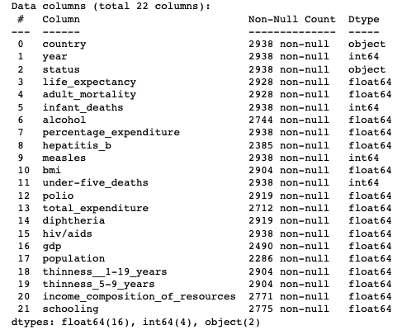
1b. Data Column Fixes
Before
After

Slide 8
2. Missing Data Identification
Summary:
29% data missing from “Population” column
23% data missing from “Hepatitis B” column
18% data is missing from “GDP” column
Result: Removed columns having high volume of missing data.

Slide 9
3a. Correlation of Data columns
Summary:
Infant deaths and under-five death have 0.99 correlation
Infant deaths are superset of under-five
Keeping “infant_deaths” for the spread
Thinness 5-9 years and Thinness 1-19 years have 0.93 correlation
1-19 is superset of 5-9
Keeping “thinness_1-19_years” data for spread
GDP vs percentage expenditure have 0.89 correlation
Keeping “percentage_expenditure” as GDP has big missing data chunk

Slide 10
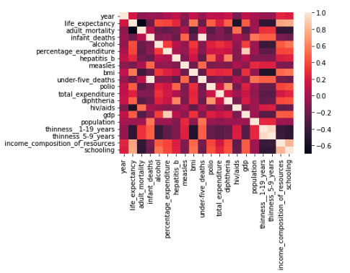
3b. Correlation by Visualization [Heatmap] (cont.)

Slide 11
4a. Outliers Identification and Imputation
Summary:
Data Point | Outlier Records (Count) | Outlier Records (%) | Method of handling
hiv/aids | 542 | 18.44% | Dropped the column
measles | 542 | 18.44% | Dropped the column
under-five_deaths | 394 | 13.41% | Drop the rows
percentage_expenditure | 389 | 13.34% | Drop the rows
infant_deaths | 315 | 10.72% | Drop the rows

Slide 12
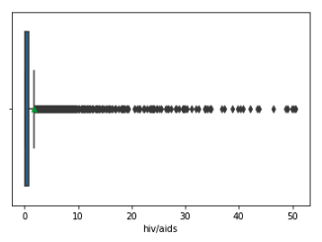
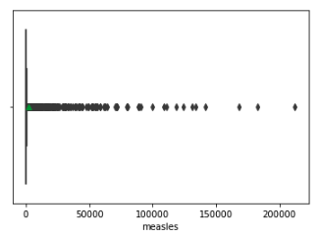
4b. Outliers by Visualization [BoxPlot]

Slide 13
5a. Data Distribution
Summary:
Identify data uniformity
Low Density [handled in previous step]
Too much diversity

Slide 14
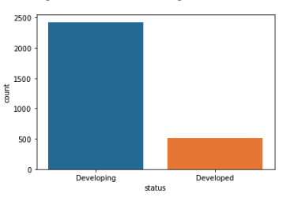
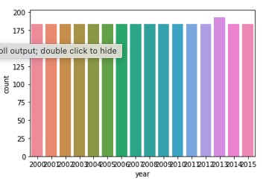
Data Distribution
Uneven Status Distribution
[Bar Plot]
Uniform Data Samples YoY
[Count Plot]

Slide 15
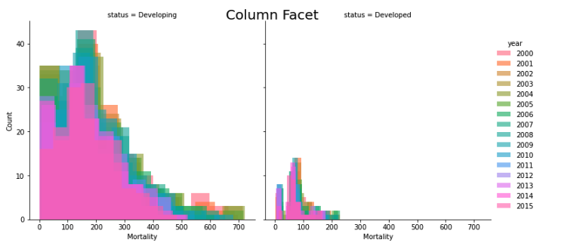
Data Spread/Distribution
Mortality rate was high and reducing over the years
[FacetGrid Plot]

Slide 16
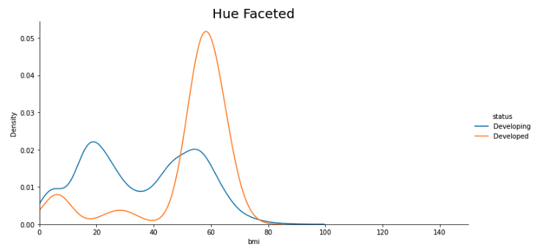
Data Spread/Distribution [FacetGrid Plot]

Slide 17
6. Script & Automation
– gr5regression.csv – Life Expectancy – [ “Country”, “Year”, “Status” ] – Prime Numbers between 1-500 – 4 – > 0.9 or < -0.9 – 10% of actual data – 10% of actual data – < 8 – > 5%
Script Config Parameters:
Input Data Path
Output Component
Discrete Components
Random State Values
KNN Imputer num of neighbors
Highly Correlation
Test Size
Acceptance % of empty data
Unique values count for One hot encoding
Outliers column Removal

Slide 18
6a. Methods Used in Script
Mode Or Median
KNN Imputer
Normalisation
Standardisation
PCA
Outliers Removal
One Hot Encoding

Slide 19
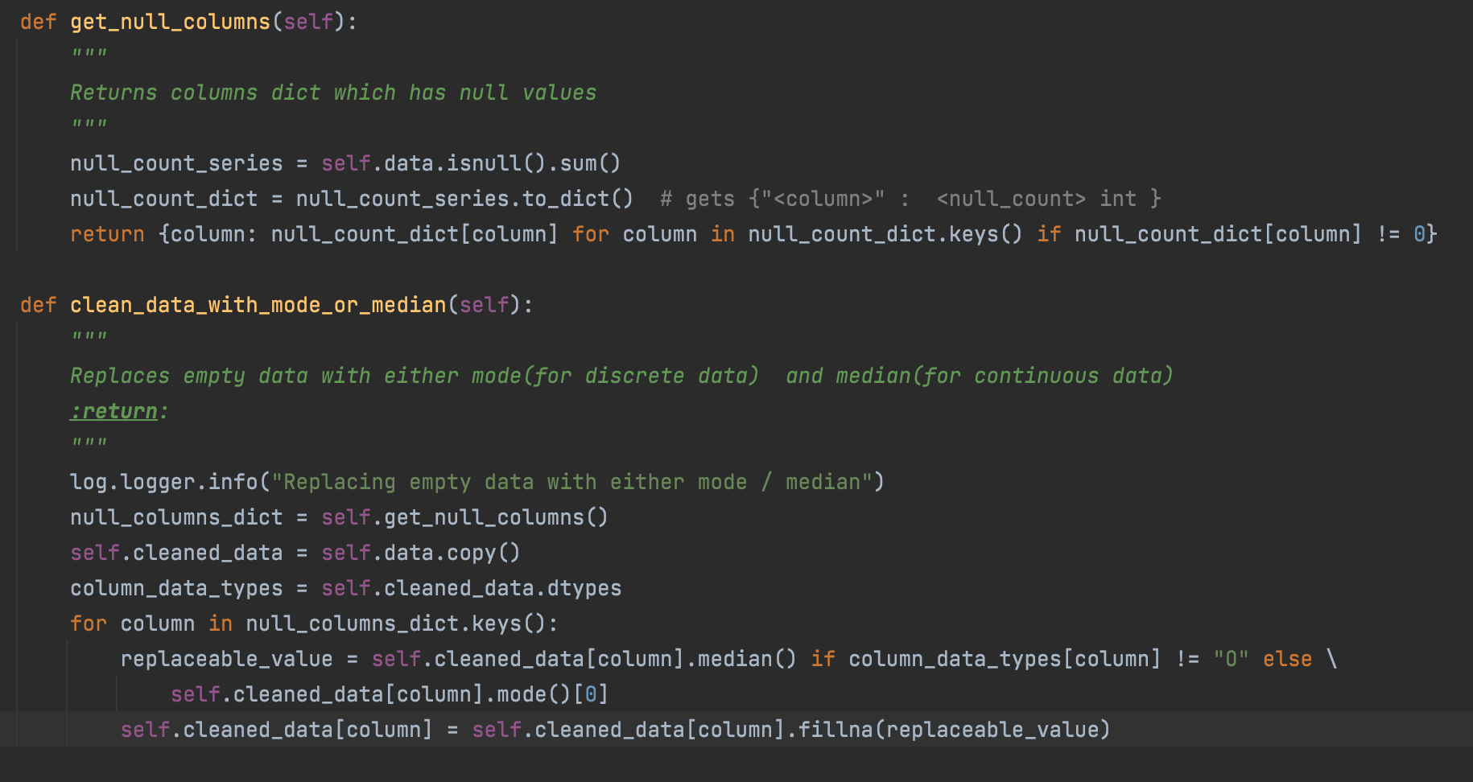
6b. Important Methods

Slide 20
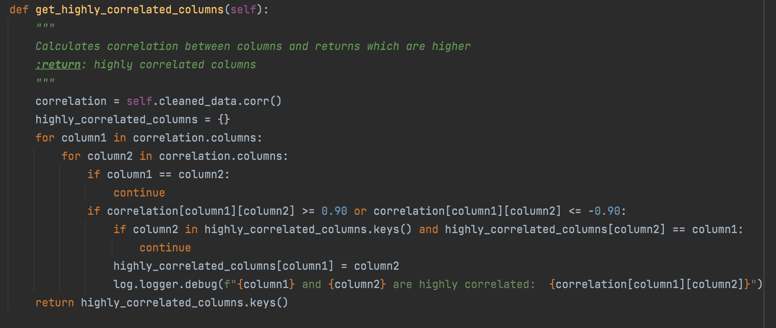
6b. Important Methods

Slide 21
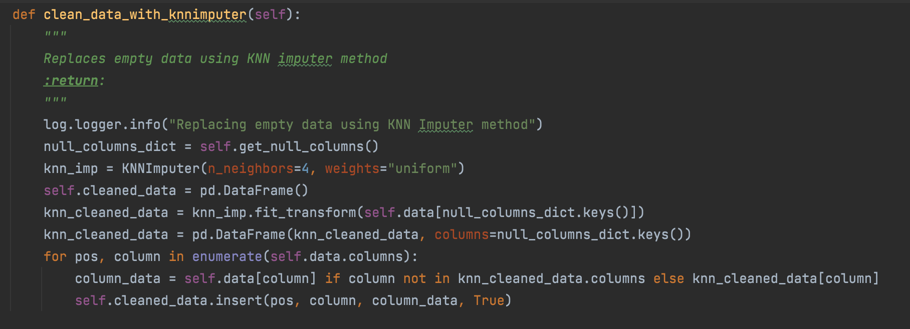
6b. Important Methods

Slide 22
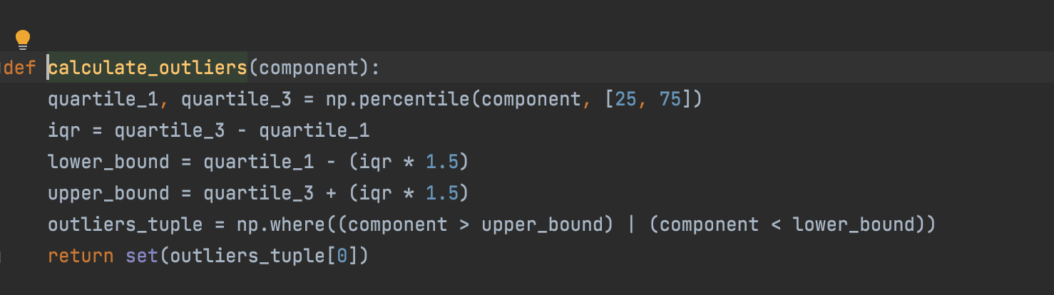
6b. Important Methods

Slide 23
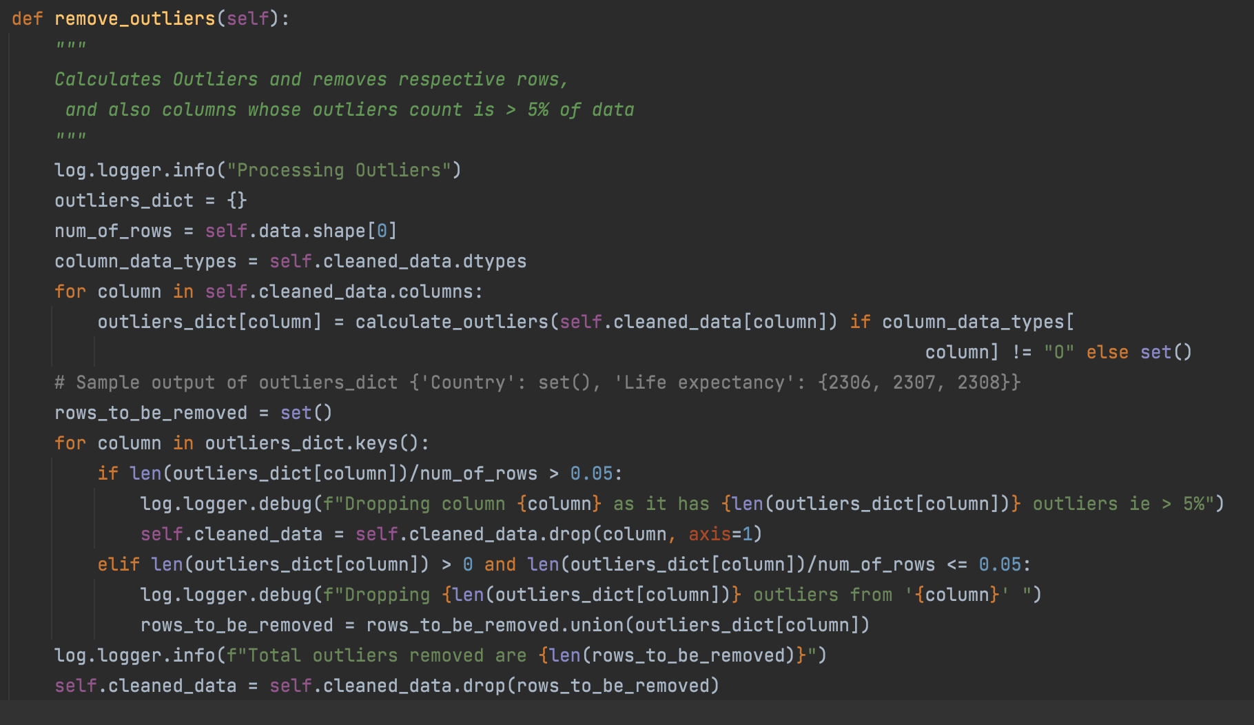

Slide 24
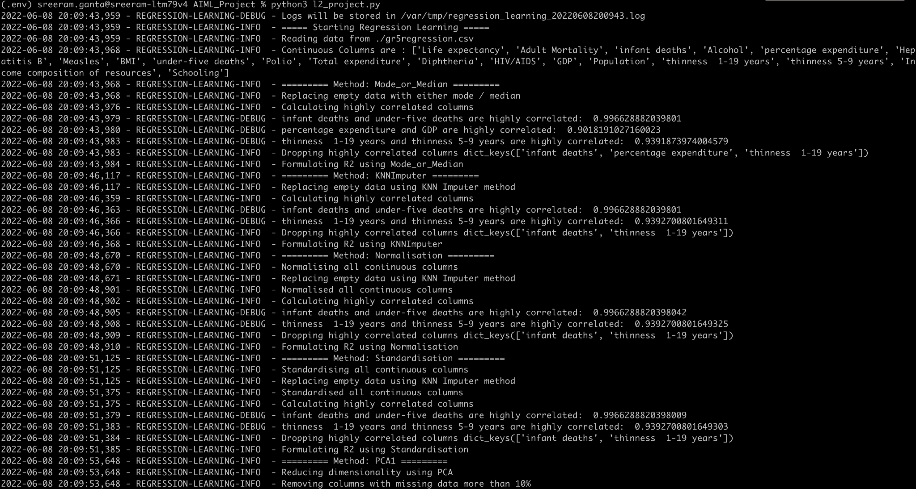

Slide 25
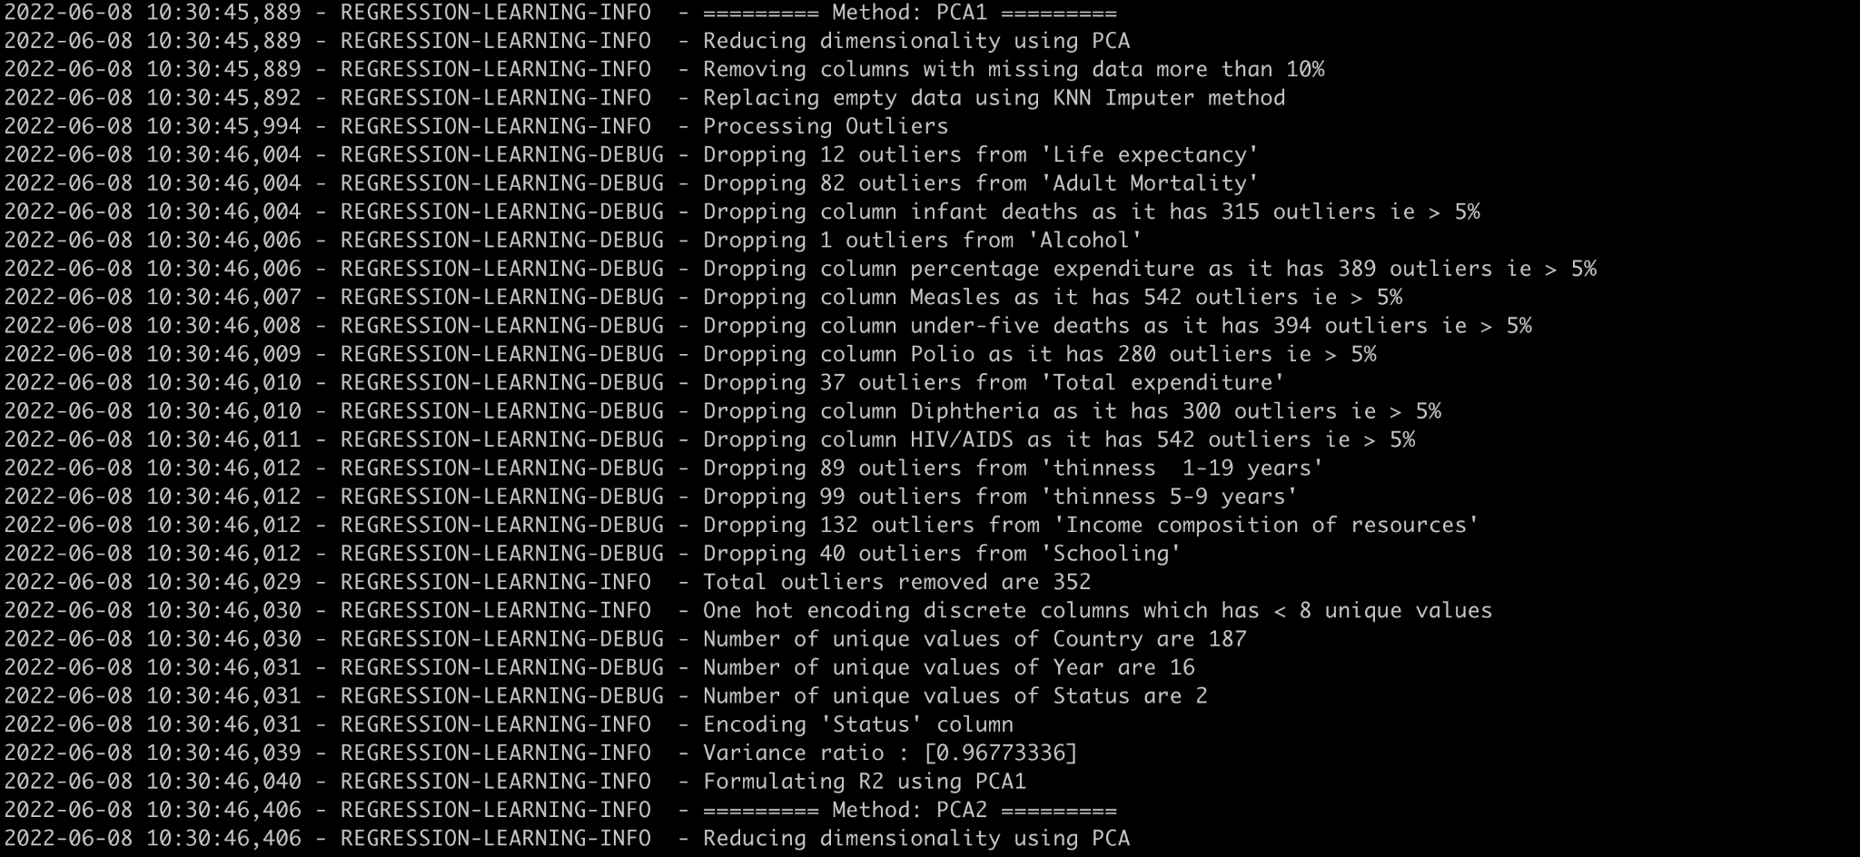

Slide 26
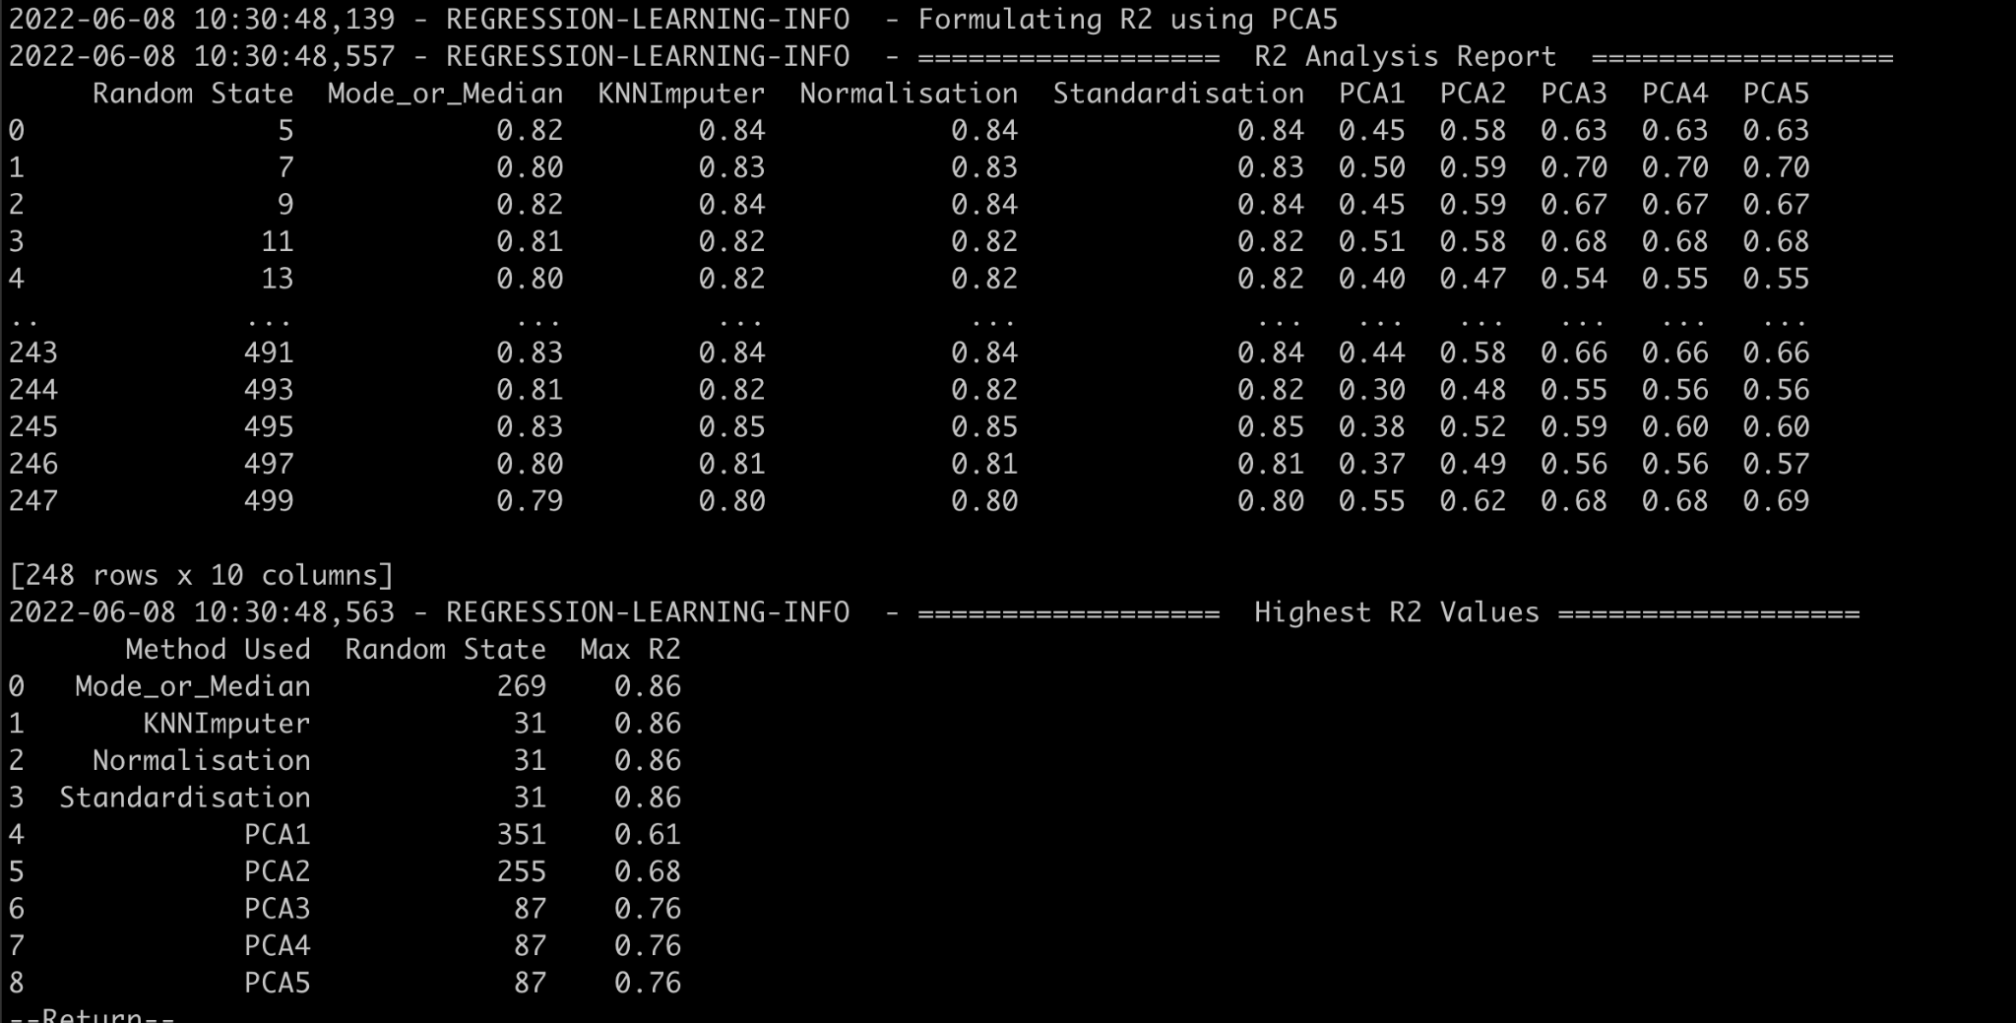
6c. R2 Report

Slide 27
DEMO

Slide 28
Our Learnings
KNNImputer / Normalisation / Standardisation alone gets effective R2 score. These can be used when dealing with less columns
Reducing dimensions using PCA might affect R2 score
Got negative R2 score in PCA1 method, this occurs when data has more outliers columns.
Negative R2 also comes when we delete more outliers rows from data.
Figured out list of config parameters which affect the R2 score for each method

Slide 29
Future Scopes
Optimise script to support all kinds of data
Have a config file as an input to the script
Create different tabular data for different config parameters
Code Reference: https://github.com/sreeram514/AIML_Project

Slide 30
Q&A

